Slide 1
Instructions to Complete the NY Workers’ Compensation Premium Credit Application for NYSIF Clients
800-462-6435
585-381-8070
www.flandersgroup.com

Slide 2
Part 1 of 2
The following pages will show you how to transfer the correct information from your policy to your written CPAP application
You will need to have your current NYSIF Workers’ Compensation Insurance Policy out
For ease of completing the on line application, we suggest you first fill out the paper application
For more program information go to:
http://www.flandersgroup.com/new-york-construction-classification-premium-adjustment-program/

Slide 3
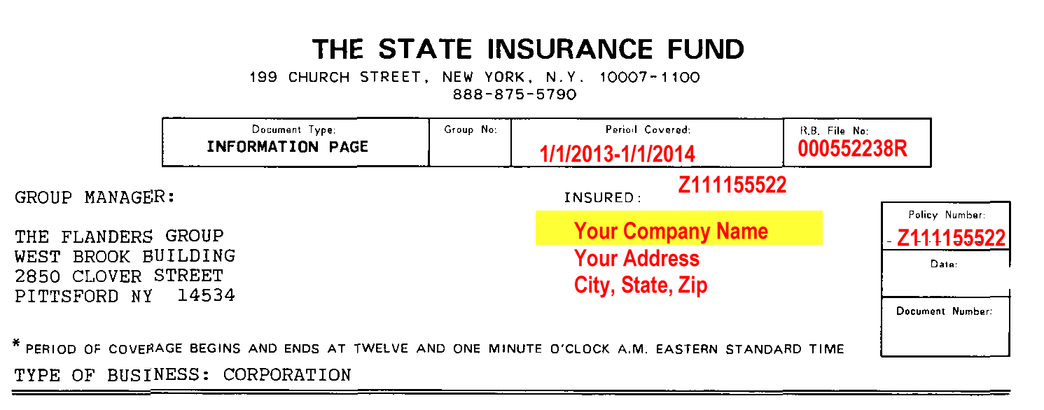
STEP 1: Copy your company name (INSURED) from your Workers Compensation policy in the highlighted space as noted on the application sample below

Slide 4
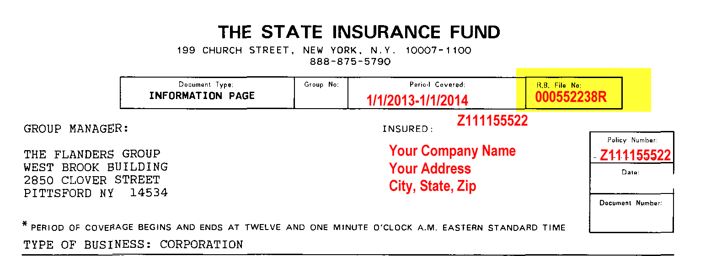
STEP 2: Copy your RB FILE # from your Workers Compensation policy to the COVERAGE ID No. highlighted space as noted on the application sample below

Slide 5
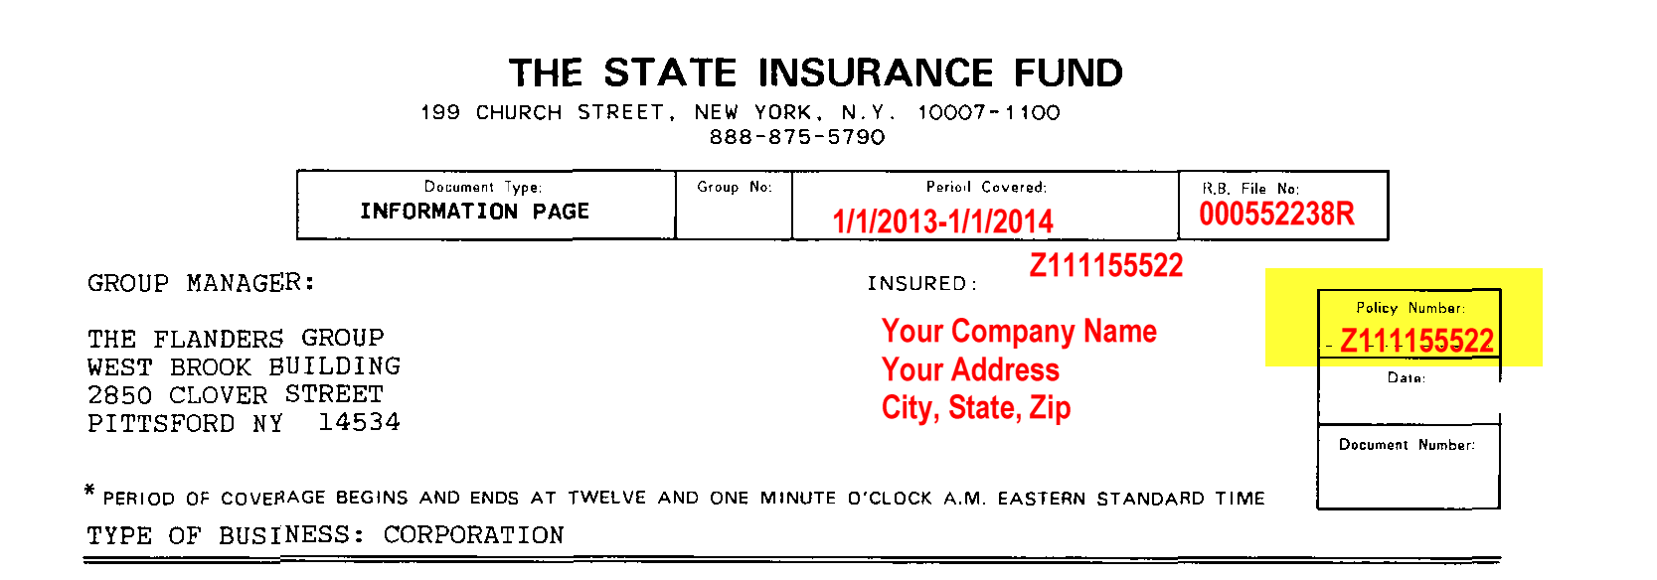
STEP 3: Copy your POLICY NUMBER from your Workers Compensation policy to the highlighted space as noted on the application sample below
Be sure to include the letter that appears before the number – no spaces or dashes

Slide 6
STEP 4: Copy the EFFECTIVE DATE from the chart below based on which safety group you are in to the highlighted space as noted on the application sample. If you are not a safety group member, please call our office at 800-462-6435 for assistance.
Safety Group # | Effective Date
512 | 1/1/16
517 | 3/31/16
453 | 4/1/16
572 | 5/1/16
563 | 5/31/16

Slide 7
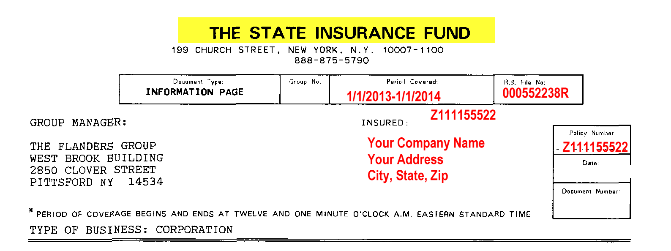
STEP 5: Copy the CARRIER from your Workers Compensation policy to the highlighted space as noted on the application sample below

Slide 8
STEP 6: Determine the 3rd quarter payroll dates that will be used for this application. For the 2016 application, if you are in one of our Safety Groups, the payroll needed is listed below. If you are not in one of our safety groups, please call our office for assistance. The payroll limitations will be needed for step # 9.
Safety Group # | Payroll Needed | Date to be Placed on Application | Payroll Limit for Commercial Work
512 | 3rd Quarter 2014 | 9/30/14 | $1,266.44/week
517 | 3rd Quarter 2014 | 9/30/14 | $1,266.44/week
453 | 3rd Quarter 2015 | 9/30/15 | TBD
572 | 3rd Quarter 2015 | 9/30/15 | TBD
563 | 3rd Quarter 2015 | 9/30/15 | TBD

Slide 9
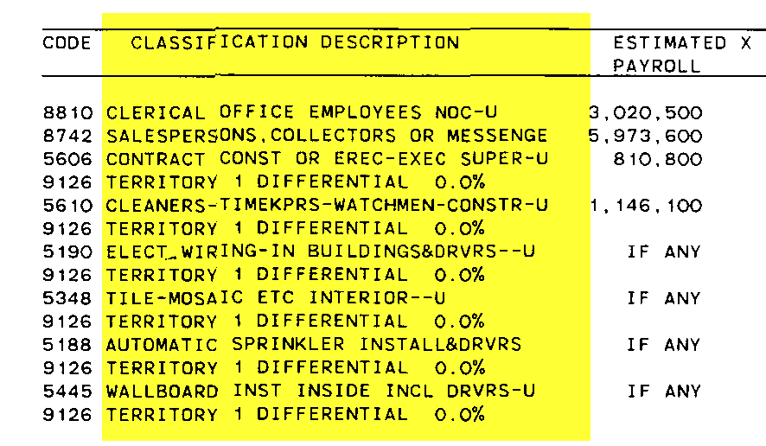
STEP 7: Copy the CLASSIFICATION DESCRIPTION from your Workers Compensation policy to the highlighted space as noted on the application sample below.
INCLUDE All class codes EXCEPT:
“If Any”
Territory Differential

Slide 10
STEP 8: Copy your CODE from your Workers Compensation policy to the highlighted space as noted on the application sample below for each classification you input from step 7.

Slide 11
STEP 9: To Prepare your 3rd quarter wages paid (see step #6 for the correct period of time):
Pull your weekly payroll records for each employee (straight time, OT and Hrs Worked) for the appropriate period of time, especially if commercial and residential work is performed. Assign every employee to the appropriate classification code.
Input the payroll number for EACH class code to the nearest whole number
Overtime pay is to be calculated as straight time pay (not time and a half)
EXECUTIVE OFFICERS: Actual payroll should be included if they are covered.
COMMERCIAL WORK: The payroll limitation listed in step #6 will apply for all commercial work
RESIDENTIAL WORK: There is no payroll limitation for residential work
If you do both Commercial and Residential:
Look at the weekly payroll of that employee. If their commercial work payroll is LESS than the limitation include the ACTUAL amount.
If their commercial work payroll is MORE than the limitation amount, include the limited amount.

Slide 12
STEP 10: Input 3rd quarter wages paid to all employees. For those employees who’s payrolls are capped, please use the maximum allowable for each individual.

Slide 13
Step 10: Input total hours worked for the class codes noted. EXECUTIVE OFFICERS and SALARIED EMPLOYEES: use 520 hours (40 hours/week x 13 weeks) regardless of the hours of actually worked. Round to the nearest whole number.

Slide 14
Part 2 of 2
Take the completed paper application and use it to complete the on line form.
Go to: http://cpap.nycirb.org and follow these steps

Slide 15
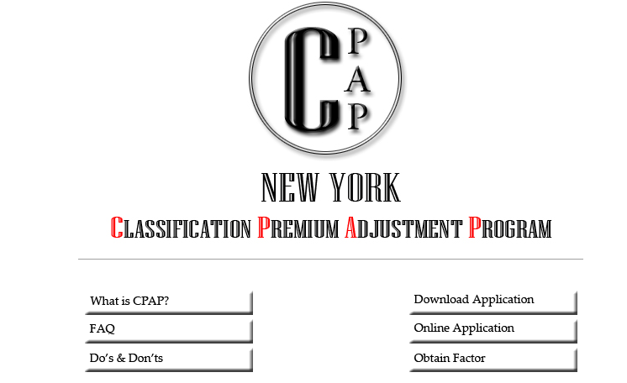
STEP 1: Click on “On Line Application” .

Slide 16
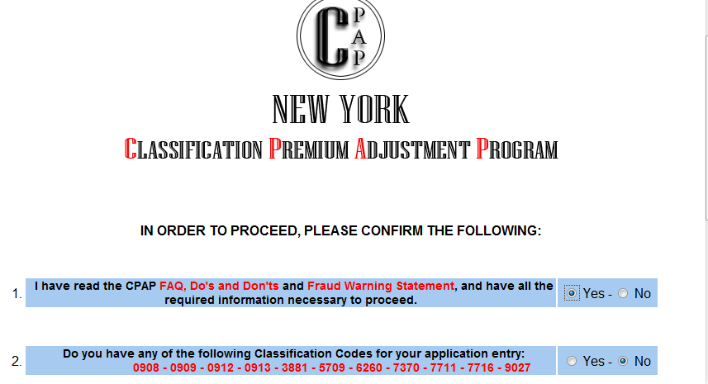
STEP 2: Confirm the requested information by answering “yes” to Question 1 and “no” to question 2.

Slide 17
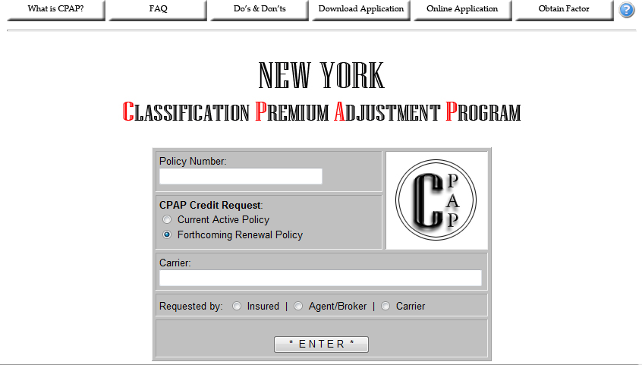
STEP 3: Enter your policy number and answer the other 3 questions as indicated below
The NY State Insurance Fund

Slide 18
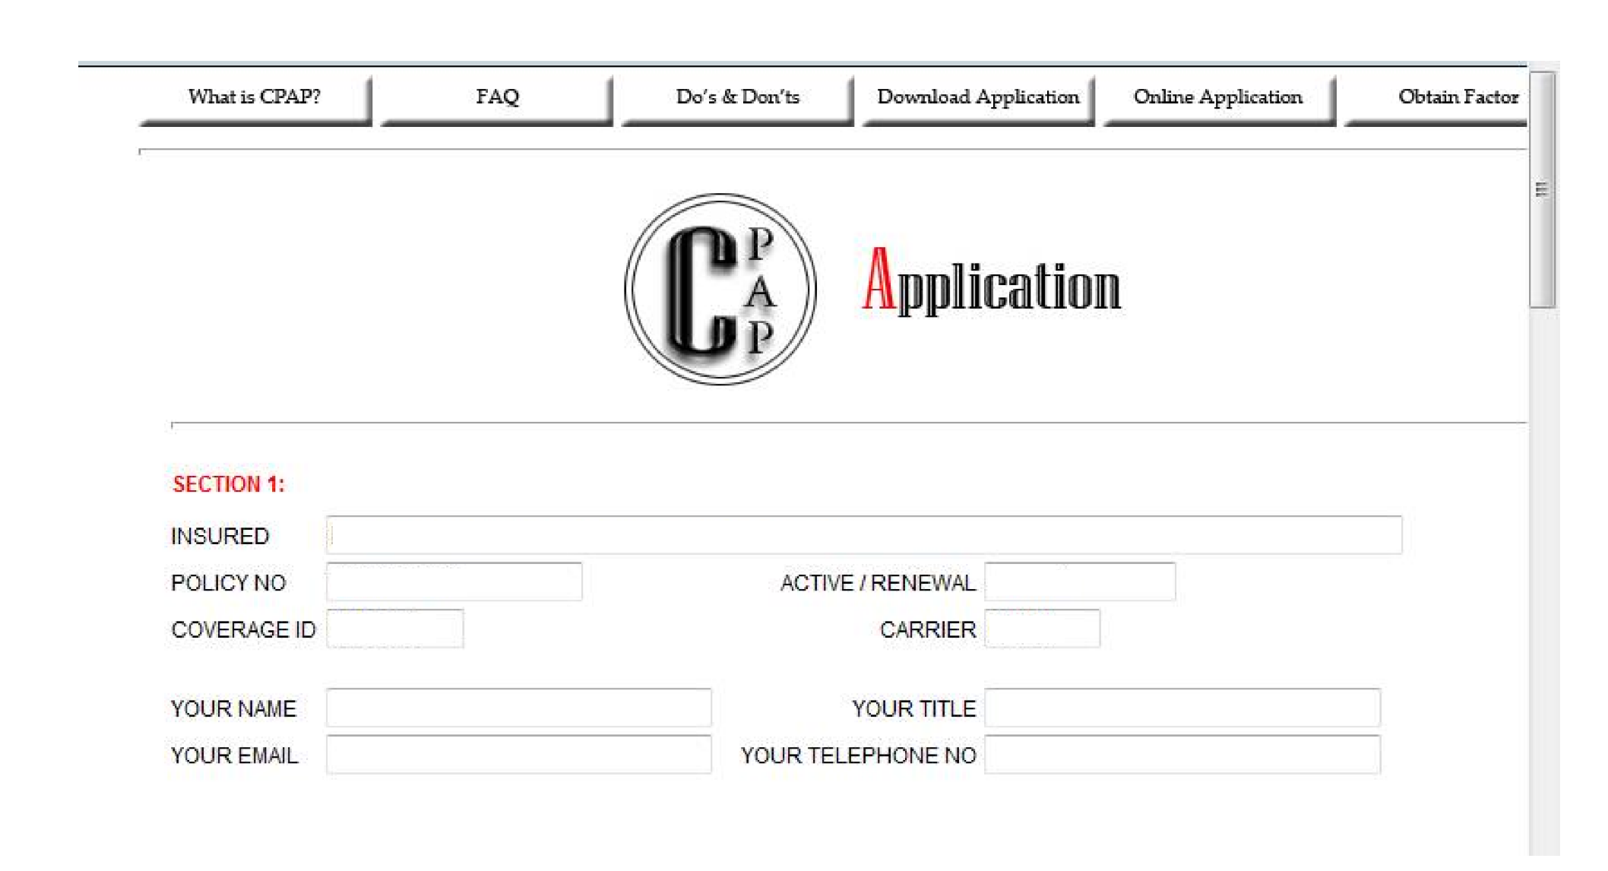
STEP 4: Fill out your policy information.

Slide 19
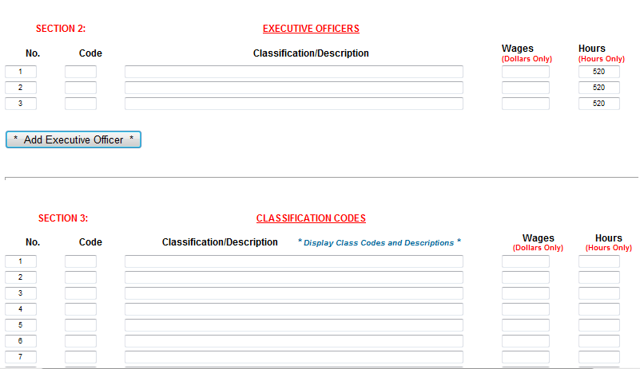
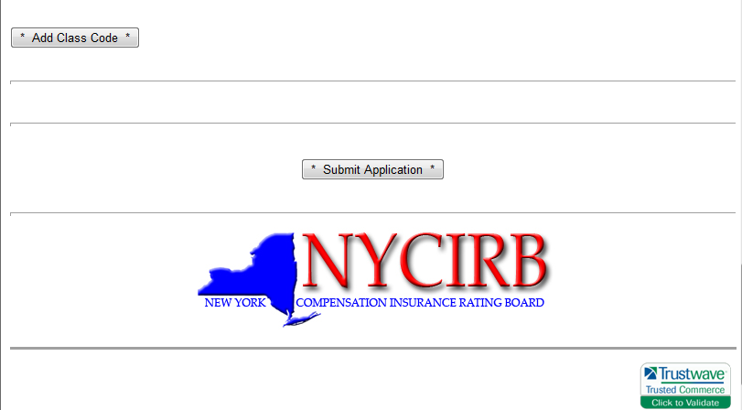
STEP 5: Fill in your payroll information and click “submit application”

Slide 20
STEP 6: Print out the confirmation email when received.
Date
Your application has been received and will be processed shortly. Please allow 2 business days before checking on the status of this submission. When referring to this application you must use the following USER ID and PASSWORD in order to retrieve your factor and worksheet.
USER ID =
PASSWORD =

Slide 21
STEP 7: In 48-72 hours go back to http://cpap.nycirb.org and click on “obtain factor”

Slide 22
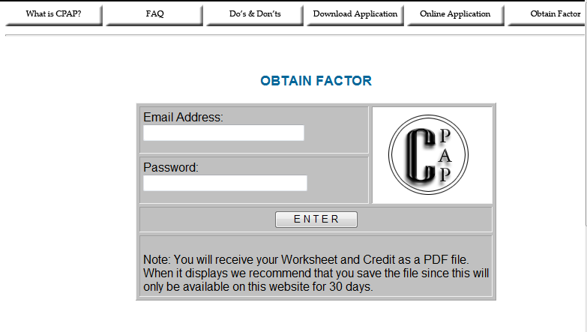
STEP 8: Enter your email address and the password you printed out from the confirmation email.

Slide 23
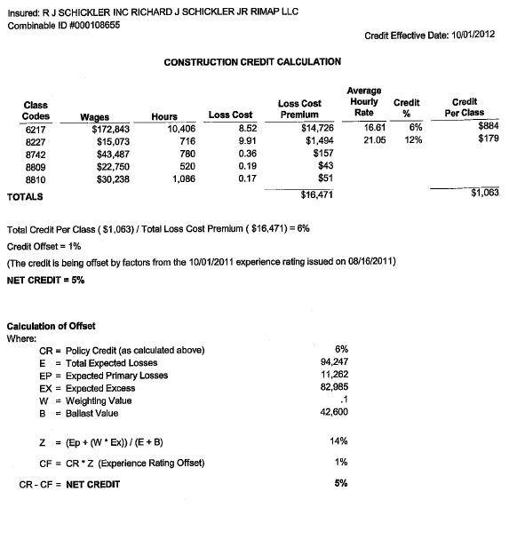
STEP 9: A worksheet will appear with your credit and how it was calculated. Please forward the credit calculation to Kathy Murty (kmurty@flandersgroup.com) so we can facilitate getting the credit on your policy.

